Slide 1




RHEL 9

Slide 2
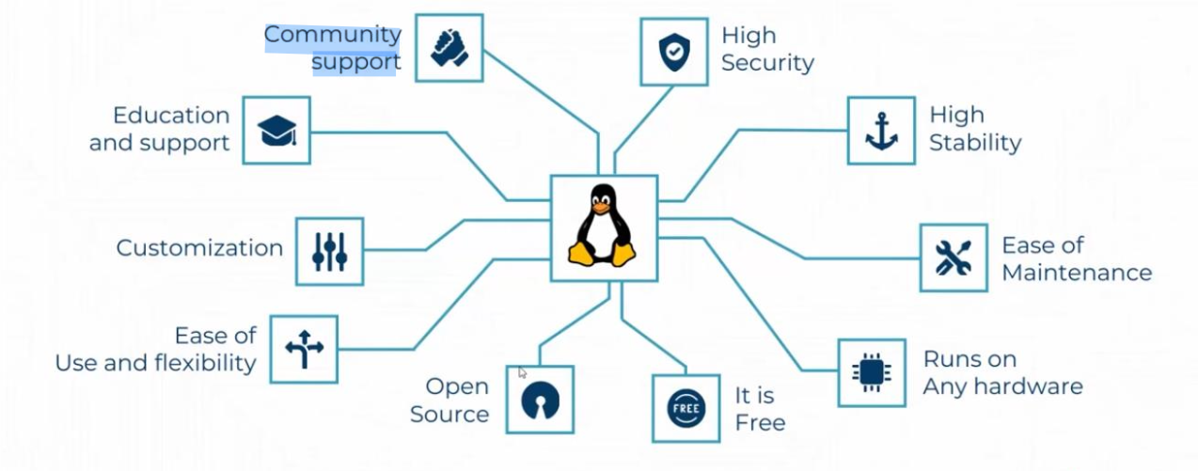
Why should you learn About Linux

Slide 3
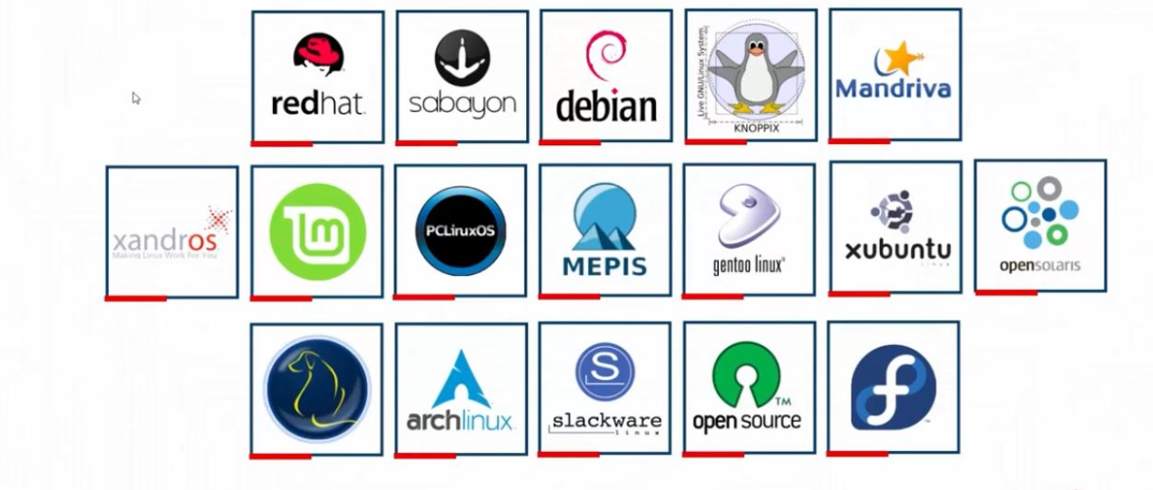
Linux Distributions

Slide 4
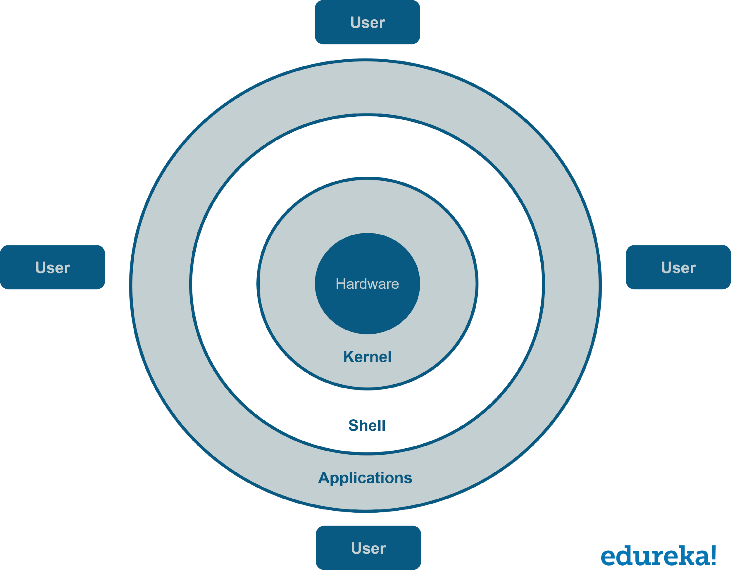
LINUX Architecture

Slide 5


Bash shell (Bourne-Again shell )
Normal User
Host Name
Working Directory
$ Normla user
Root User
Host Name
Working Directory
# Root User

Slide 6
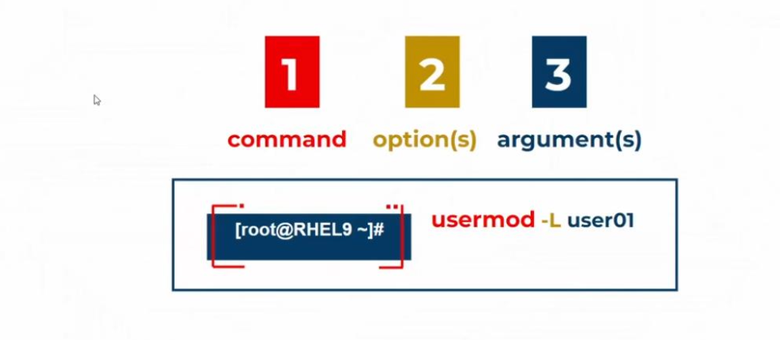
Linux command syntax

Slide 7
#Linux case senstive
#rule 1

Slide 8
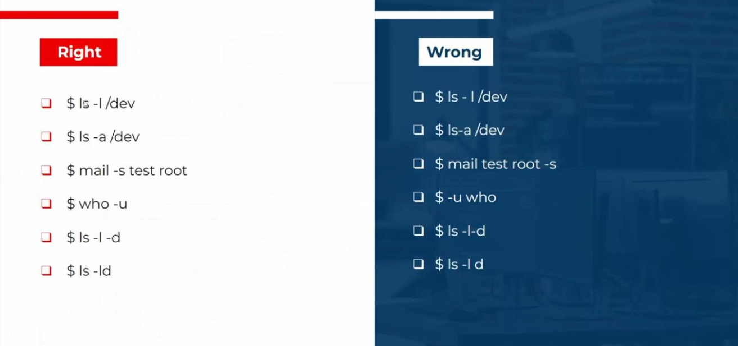
Linux command syntax

Slide 9
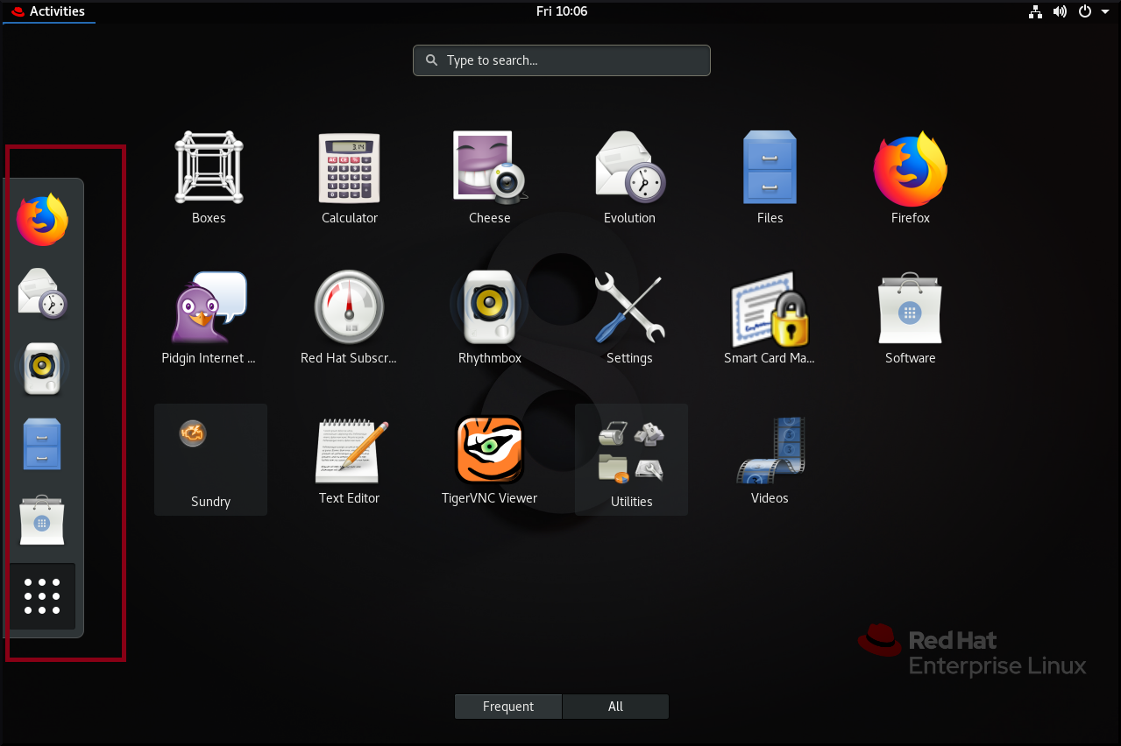
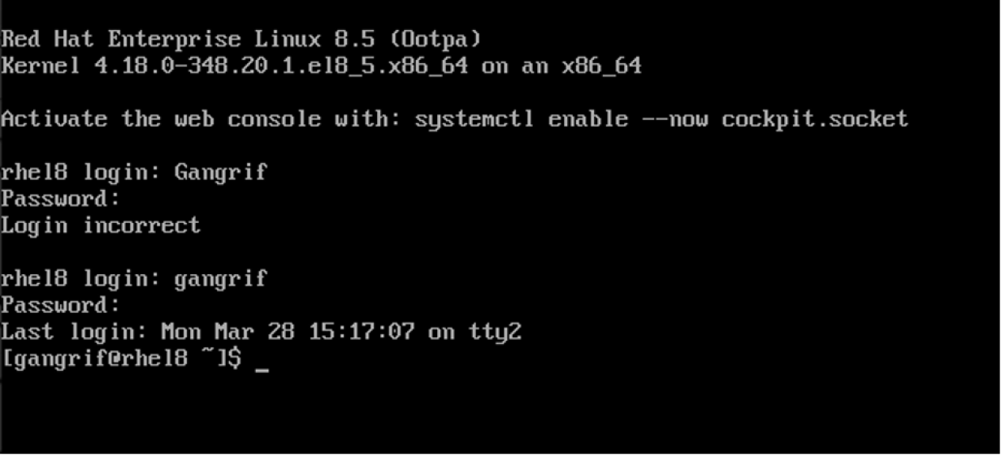
GUI vs CLI

Slide 10
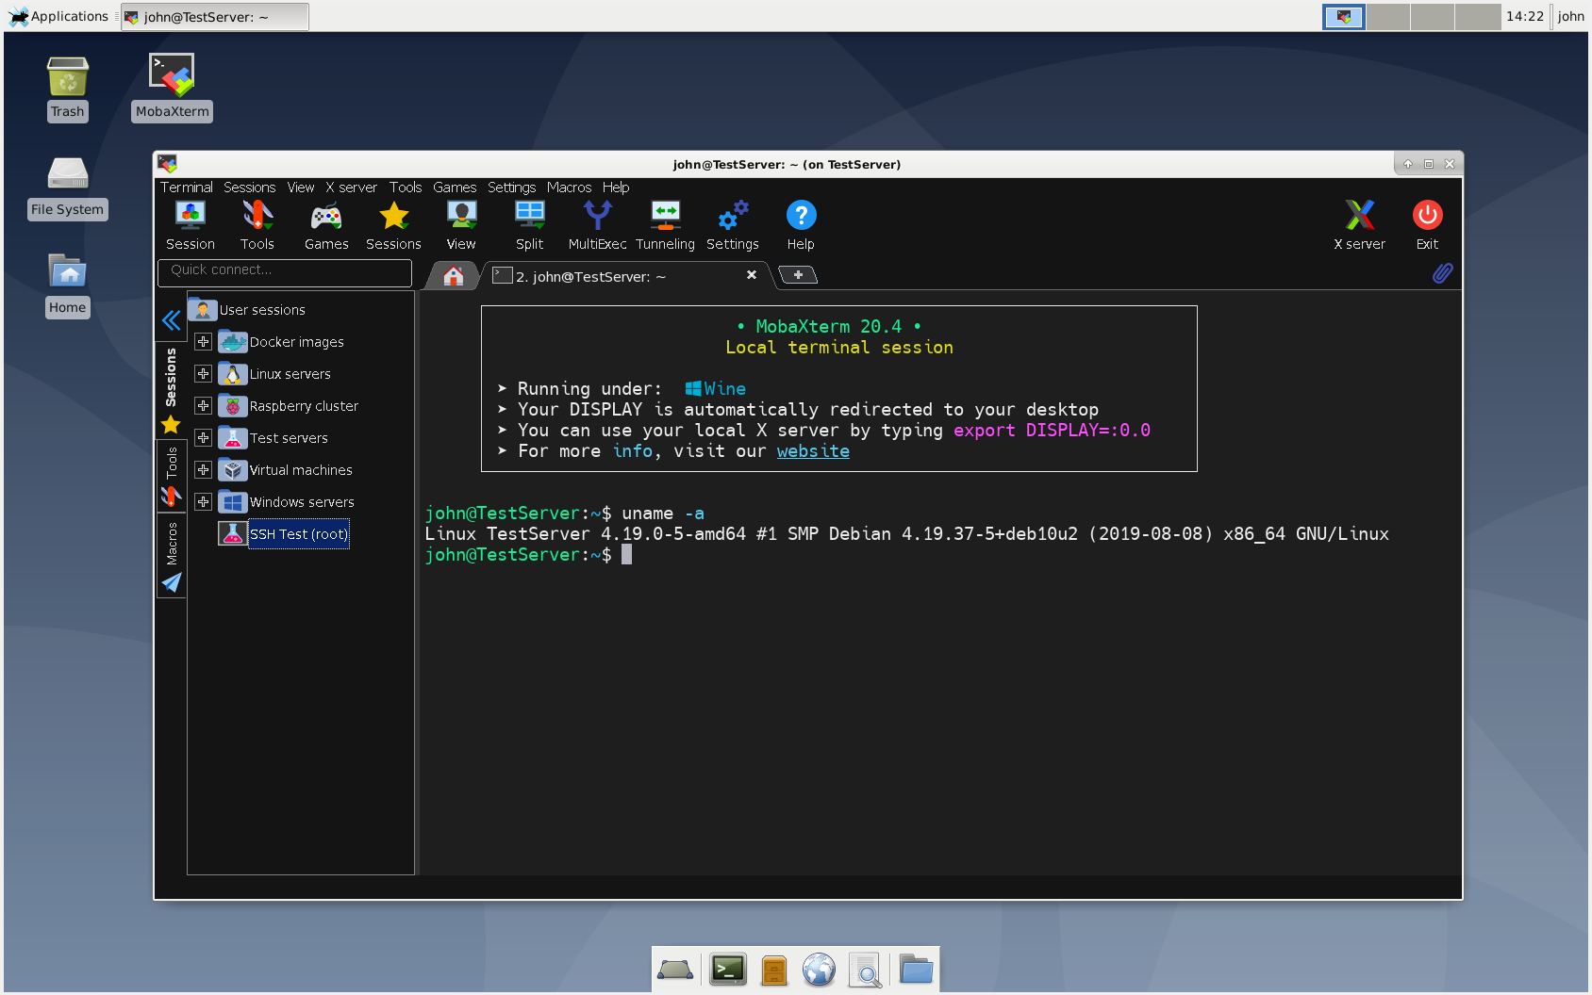
Remote access over secure shell (ssh)

Slide 11
Basic commands
date
cal
passwd
file
cat
less
more
head
tail
history
ls
id
clear
exsit

Slide 12
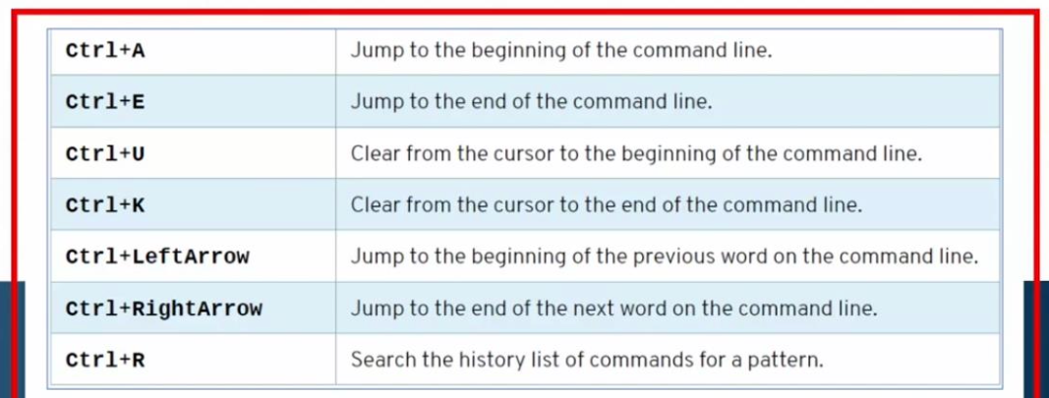
Terminal shortcuts

Slide 13
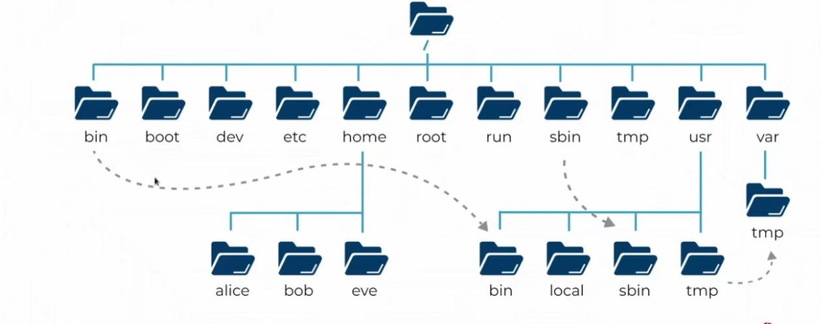
FILE-SYSTEM HIERARCHY

Slide 14
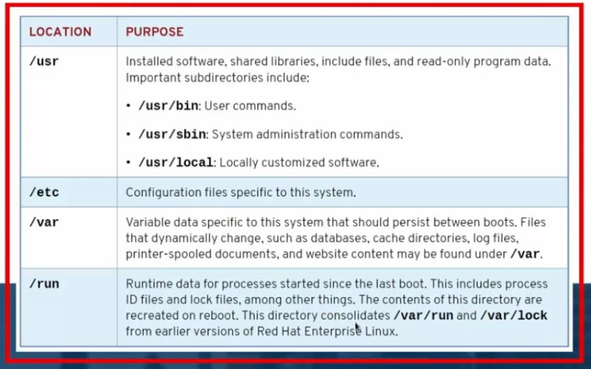
FILE-SYSTEM HIERARCHY

Slide 15
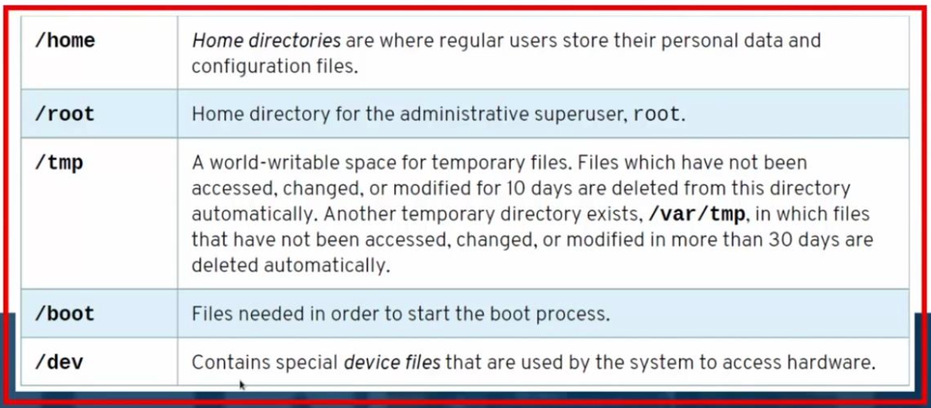
FILE-SYSTEM HIERARCHY

Slide 16
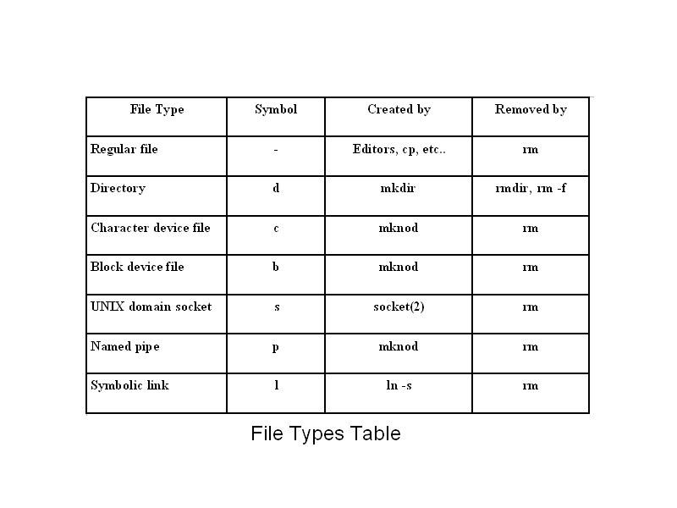
Type of files in linux

Slide 17
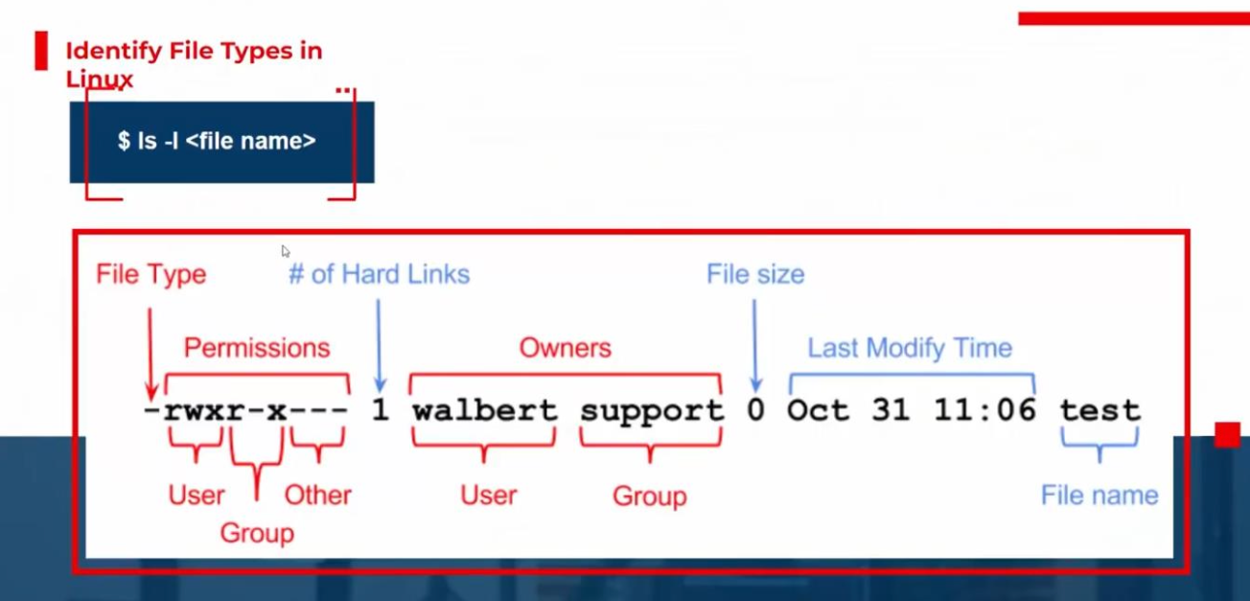
Type of files in linux

Slide 18
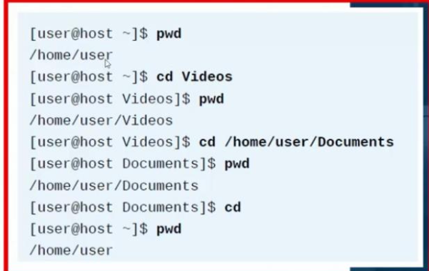
Relative vs Absolute Path

Slide 19
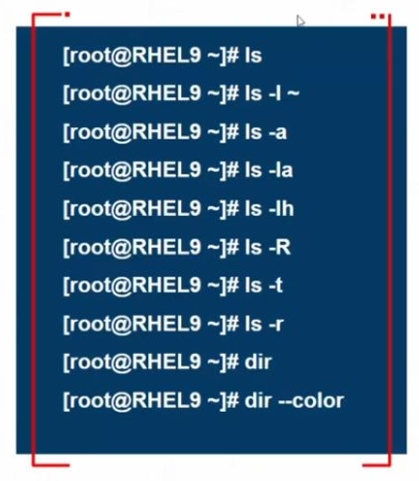
List files and Dirs (ls)

Slide 20
Commands to manage files and dirs
Command | Description
touch | Create files
mkdir | Create Folders
cp | Cope files or folders
mv | Cut or rename files and folders
rm | Remove files and folders
rmdir | Remove folders
vi | Create and open files

Slide 21
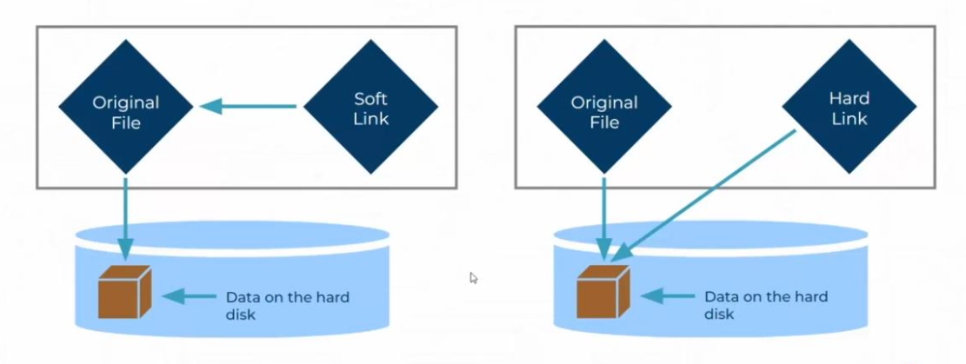
Hard links and sofy links

Slide 22
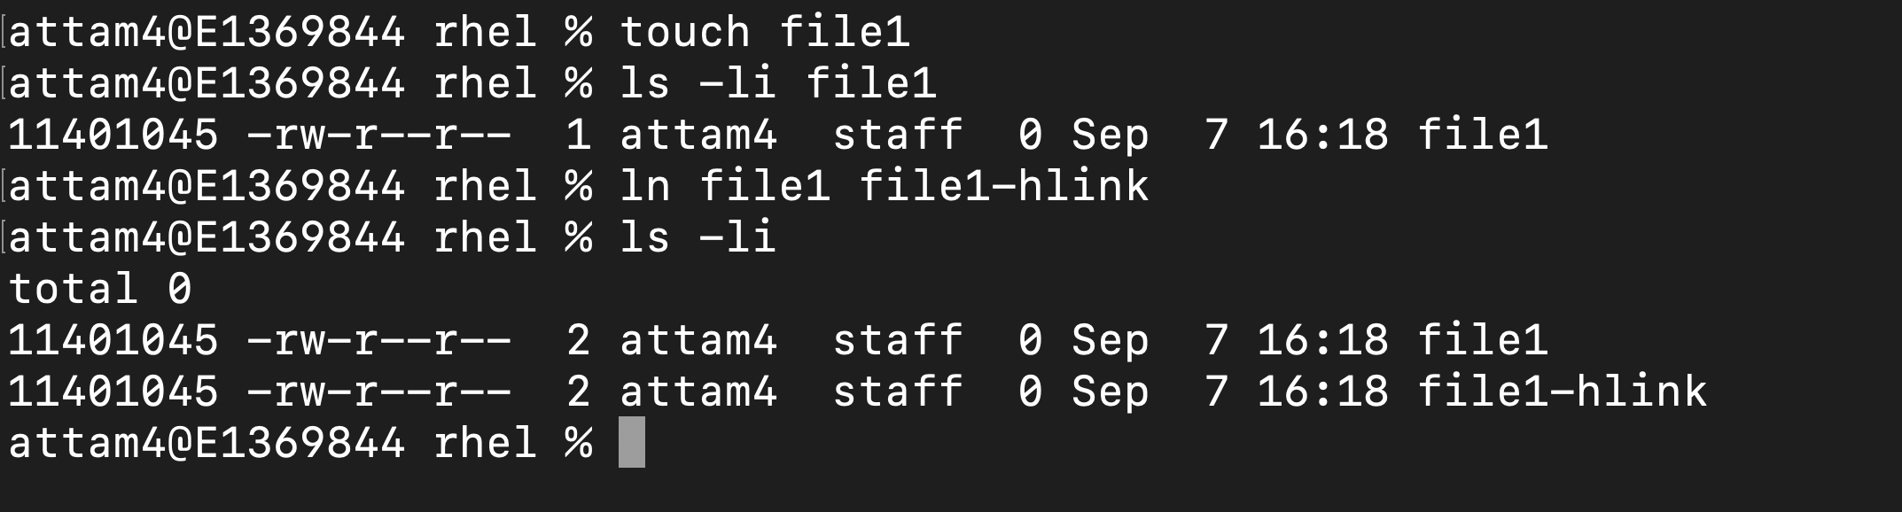
Create Hard Link

Slide 23
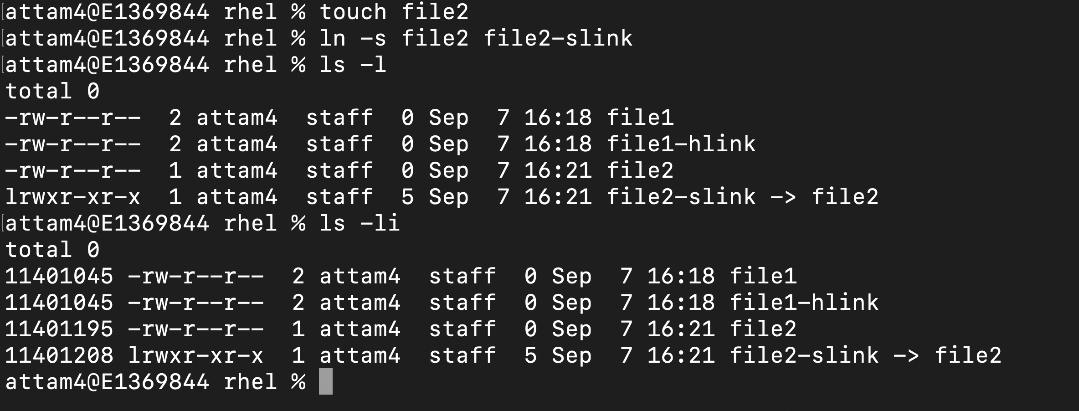
Create Soft Link

Slide 24
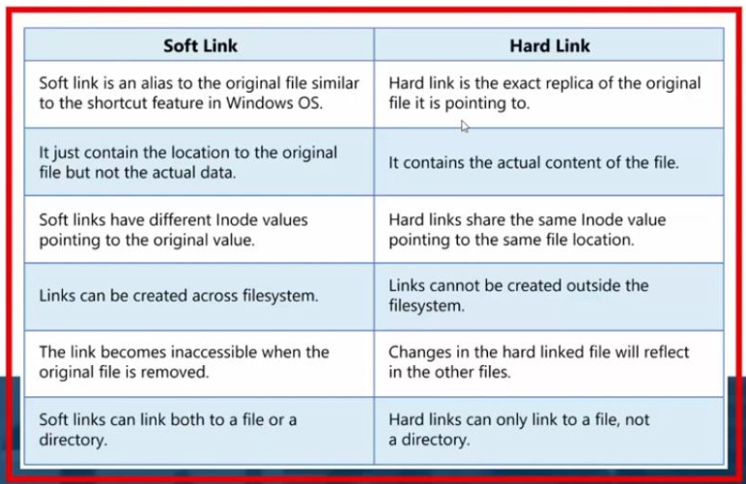
Hard Links vs Soft Links

Slide 25
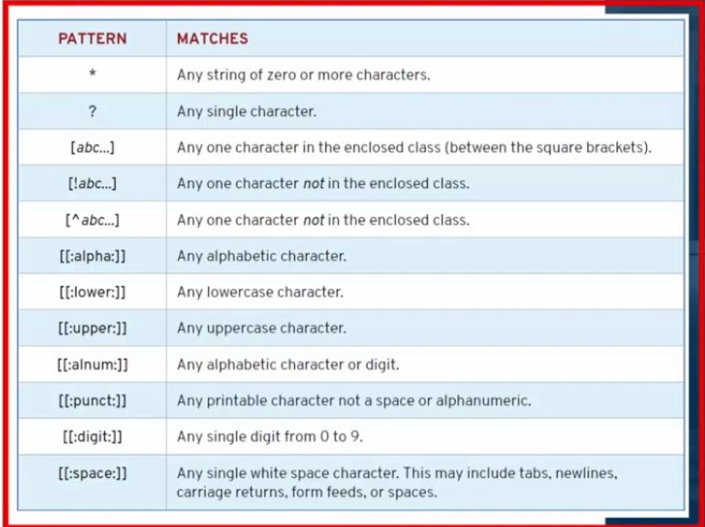
Pattern Matching

Slide 26
Regular Expressions

Slide 27
Grep command
-i | Case senstive
-v | reverse
-r | recursive
-n | Number the lines
-A3 | 3 lines after matching
-B3 | 3 lines before matching
-e | Used for multiple search patterns

Slide 28
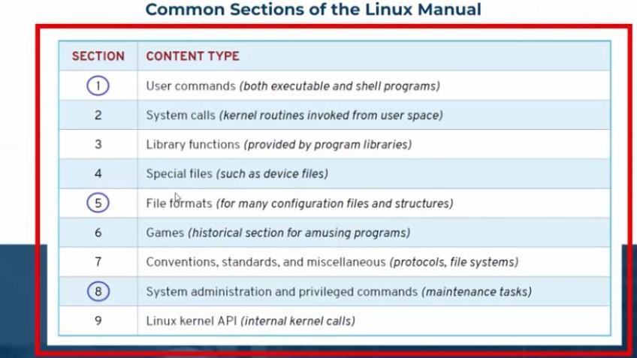
Reading manual pages

Slide 29
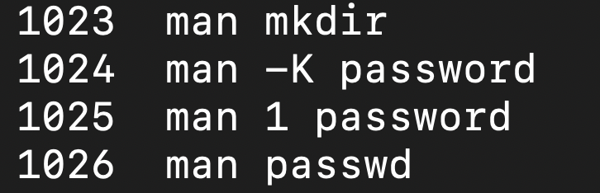
Man command

Slide 30
Summary
Getting Help From Red Hat
https://docs.redhat.com
https/access.redhat.com/documentation/en/
• The Linux d o c u m e n t a t i o n project
http://tldp.org/
• Reading Documentation in:
Man, --help, who, whereis
/ u s r / s h a r e / d o c

Slide 31
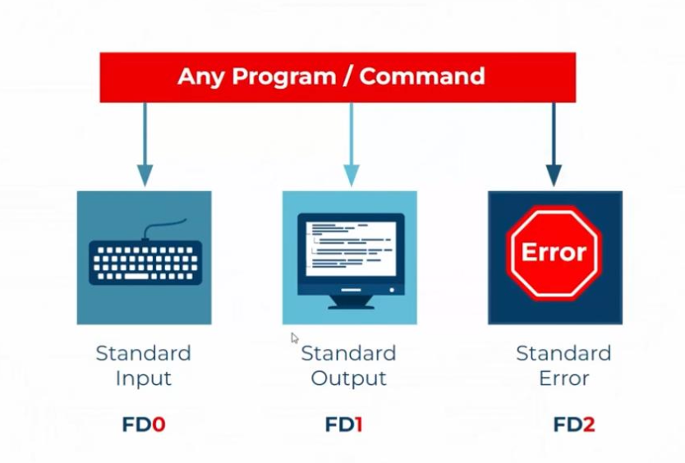
Redirection

Slide 32
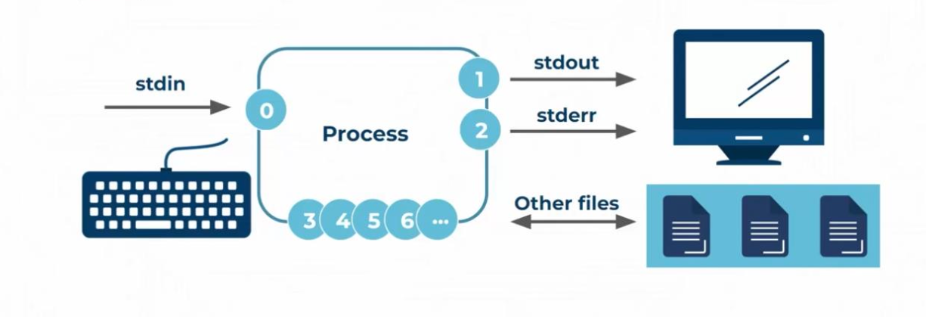
Redirection

Slide 33
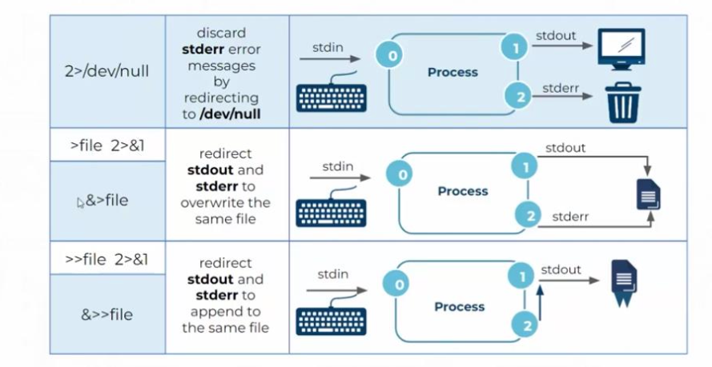
Redirection

Slide 34
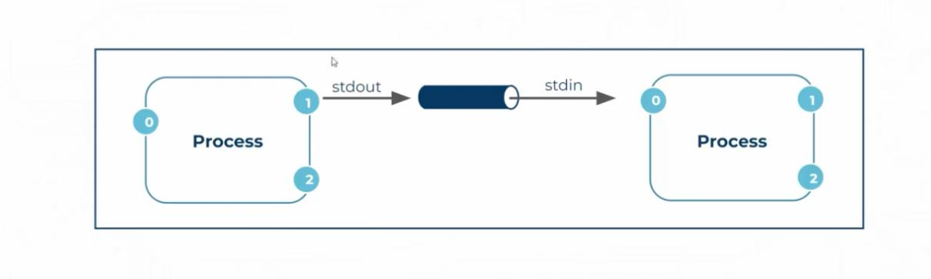
Pipelines |

Slide 35
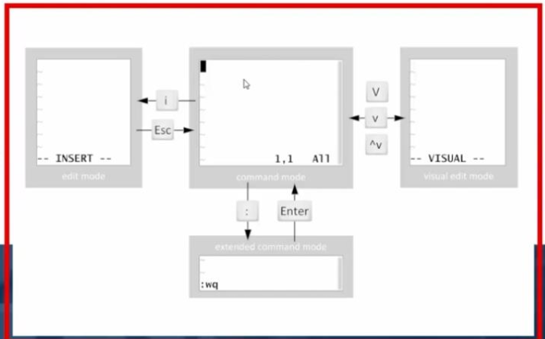
Vim editor

Slide 36
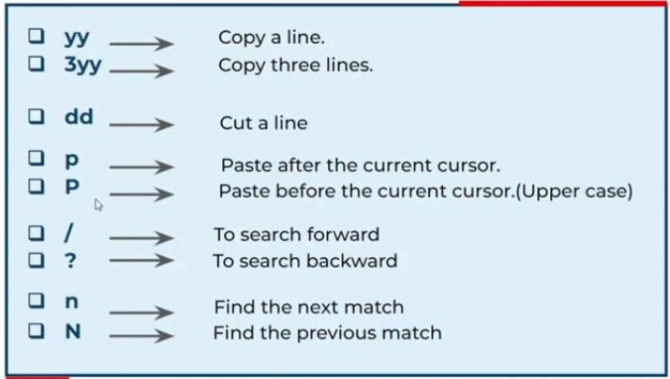
Command mode in vim

Slide 37
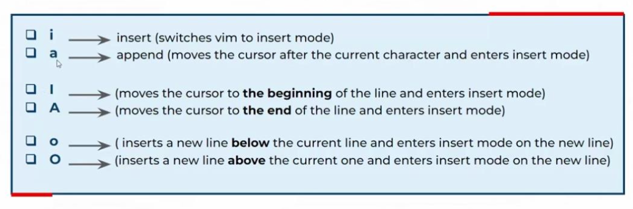
Insert mode in vim

Slide 38
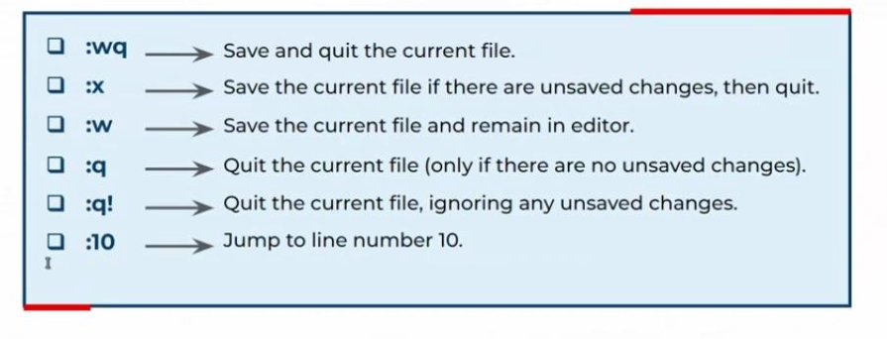
Extended mode in vim

Slide 39
What is A USER
A user account is used to provide security boundaries between different people and programs that can run commands
The system distinguishes user accounts by the unique identification number assigned to them, the user ID or UID
There are three main types of user account: the superuser, system users, and regular users.

Slide 40
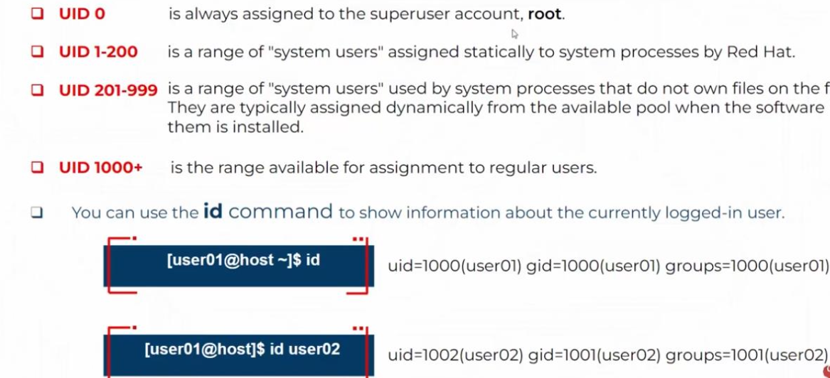
UID ranges

Slide 41
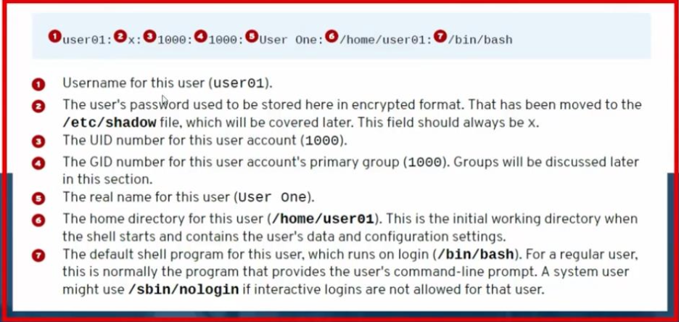
/etc/passd file

Slide 42
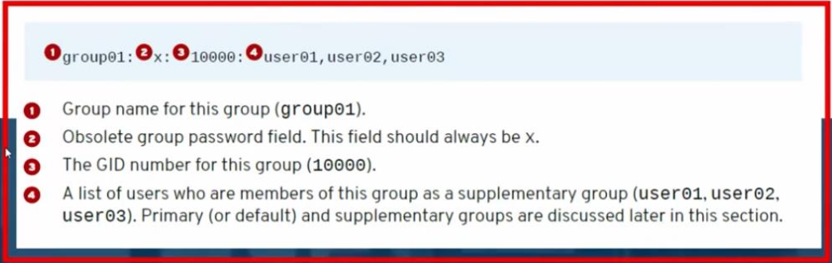
/etc/group

Slide 43
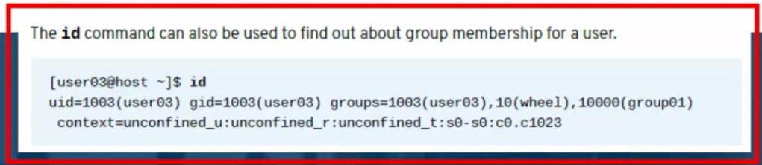
Primary group and secondary group

Slide 44
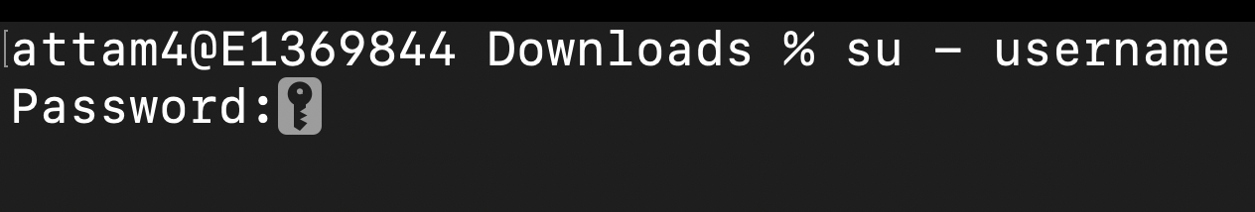
Switching users
The su command allows users to switch to a different user account. If you run su from a regular user account, you will be prompted for the password of the account to which you want to switch. When root runs su, you do not need to enter the user's password.
If you omit the user name, the su or su - command attempts to switch to root by default.

Slide 45
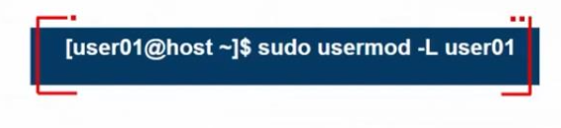
Sudo command
In some cases, the root user's account may not have a valid password at all for security reasons.
In this case, users cannot log in to the system as root directly with a password, and su cannot be used to get an interactive shell. One tool that can be used to get root access in this case is sudo.
Unlike su, s u d o normally requires users to enter their own password for authentication, not the password of the user account they are trying to access. That is, users who use sudo to run commands as root do not need to know the root password. Instead, they use their own passwords to authenticate access.
For example, when sudo is configured to allow the user0l user to run the command usermod as root,user0l could run the following command to lock or unlock a user account:

Slide 46
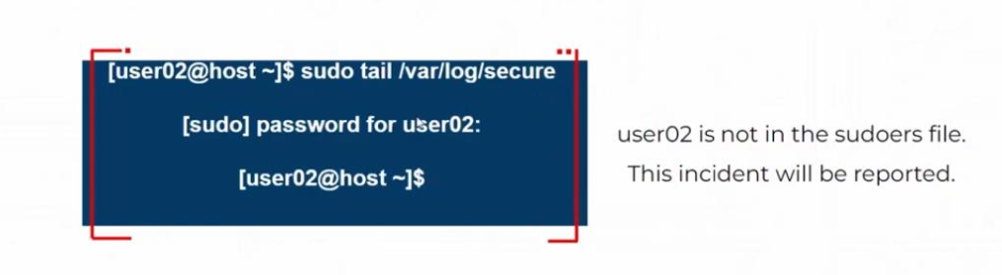
Running commands with sudo
If a user tries to run a command as another user, and the sudo configuration does not permit it, the command will be blocked, the attempt will be logged, and by default an email will be sent to the root user.

Slide 47

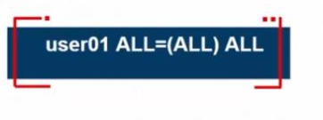

Configure sudo privillages
The main configuration file for sudo is /etc/sudoers. To avoid problems if multiple administrators try to edit it at the same time, it should only be edited with the special visudo command.
For example, the following line from the /etc/sudoers file enables sudo access for members of group wheel.
To enable full sudo access for the user user01
To enable the full sudo access for the group group01

Slide 48
Creating users from cli
The useradd usernamee c o m m a n d creates a new user n a m e d username. It sets up the user's h o m e directory and account information, and creates a private group for the user named username. At this point the account does not have a valid password set, and the user cannot log in until a password is set.
The useradd --help c o m m a n d displays the basic options that can be used to override the defaults. In most cases, the same options can be used with the usermod command to modify an existing user.
Some defaults, such as the range of valid UID numbers and default password aging rules, are read from the /etc/login.defs file.
Values in this file are only used w h e n creating new users. A change to this file d o e s not affect existing users.

Slide 49
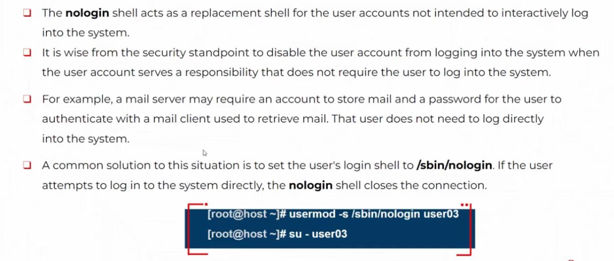
Nologin shell
This account is crruntely not available.

Slide 50
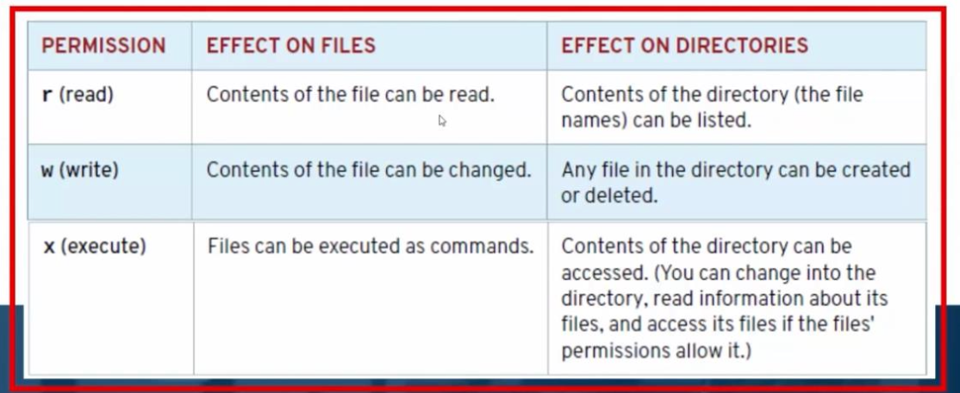
Linux File System Permissions

Slide 51
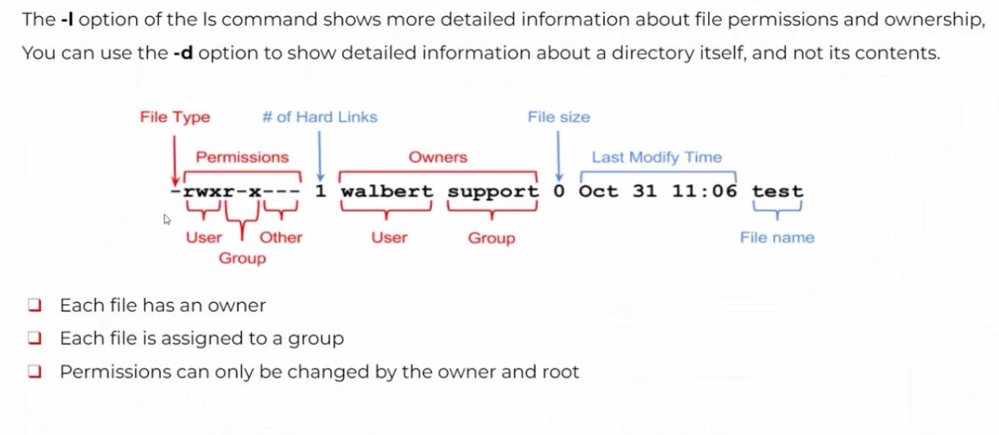
Linux File System Permissions

Slide 52
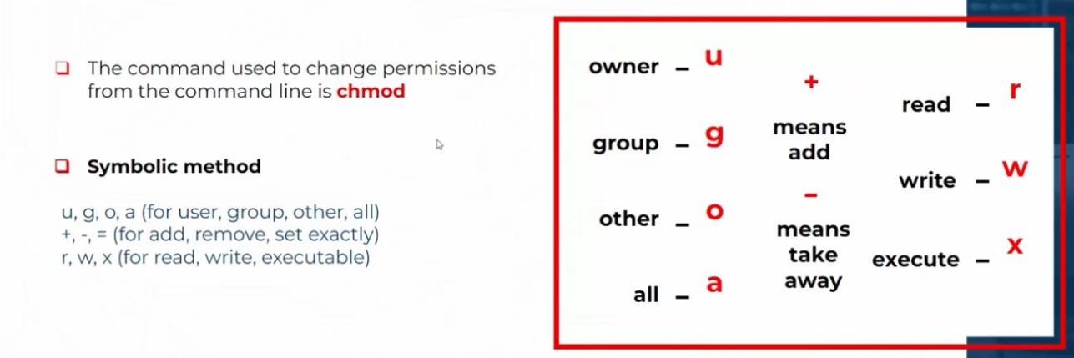
Linux File System Permissions

Slide 53
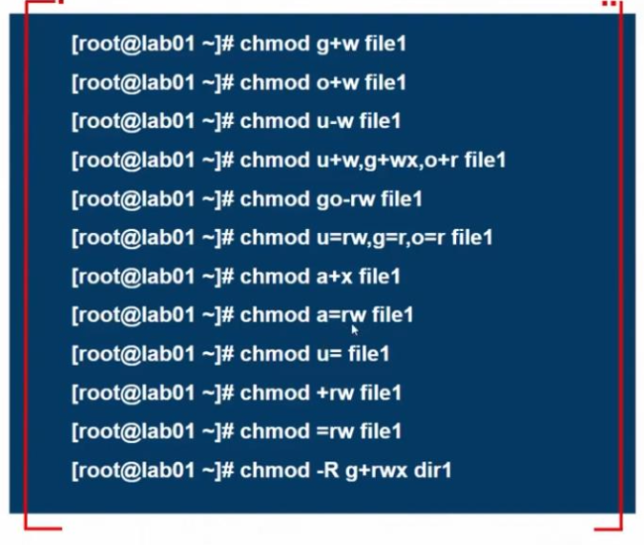
Symbolic method examples

Slide 54
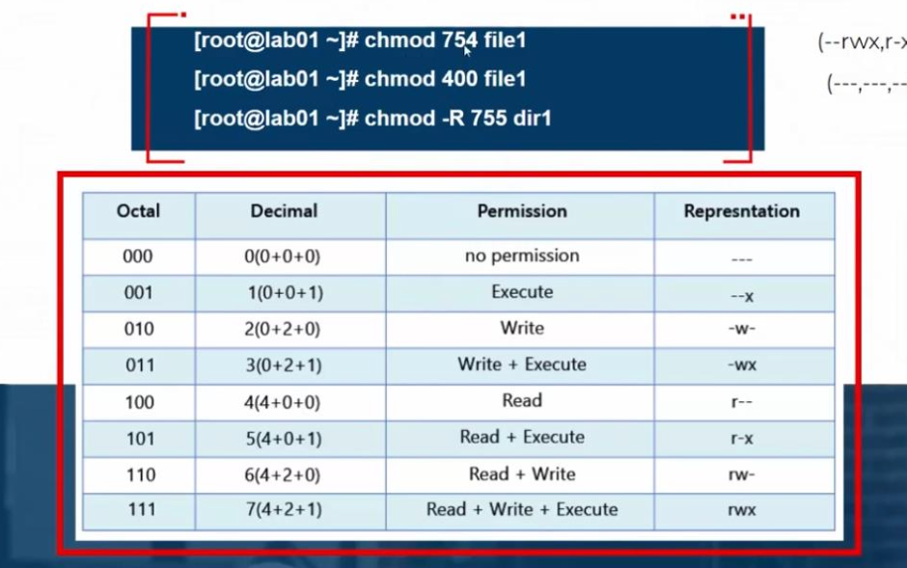
Numeric method examples

Slide 55
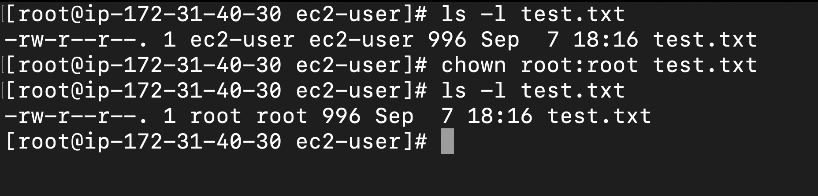
Change file & dir user or group ownership

Slide 56
Monitoring and managing Linux Process
A process is a running instance of a launched, executable program.
Every new process is assigned a unique process ID (PID) for tracking and security.
The PID and the parent's process ID (PPID) are elements of the new process environment.
Any process may create a child process.

Slide 57
Linux Process commands
ps | List the processes in your session
ps aux | List all process in all sessions
ps -ef | List all process in all sessions
pstree | Processes tree
top | Analysis el processes
htop | More advanced and GUI than top
jobs | List bg process
fg | Back the jobs to fg

Slide 58
Kill processes commands
kill | Kill the processes
Pidoff vim | Find the pid of vim
Kill -l | List all signals
Kil -9 pid | Force kill
pkill vim | Kill by proocess name
Killall vim | Kill all processes with this name

Slide 59
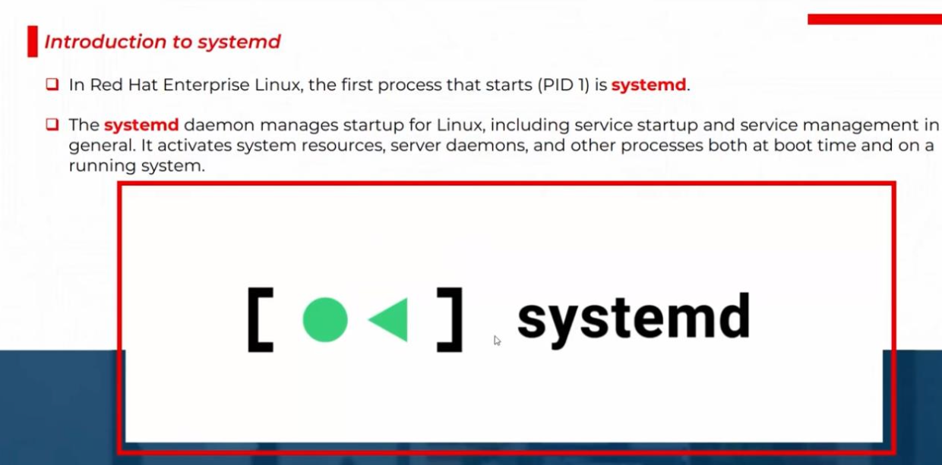

Slide 60
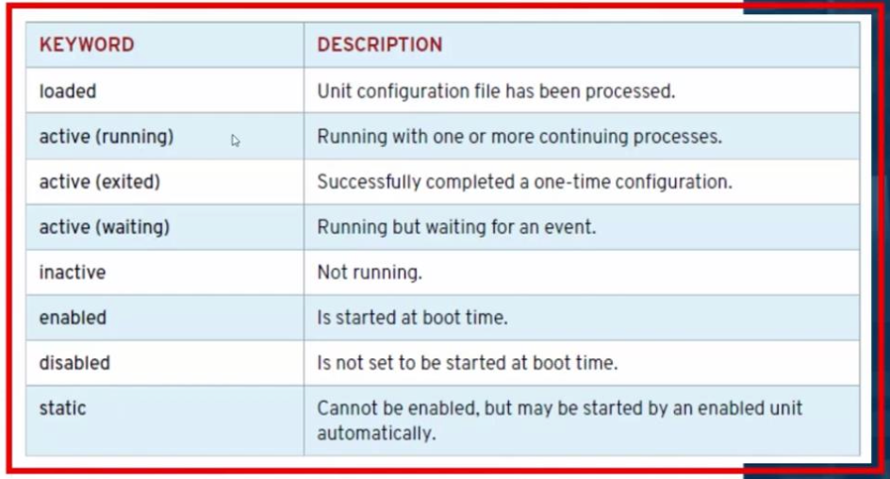
Service state in the output of systemctl

Slide 61
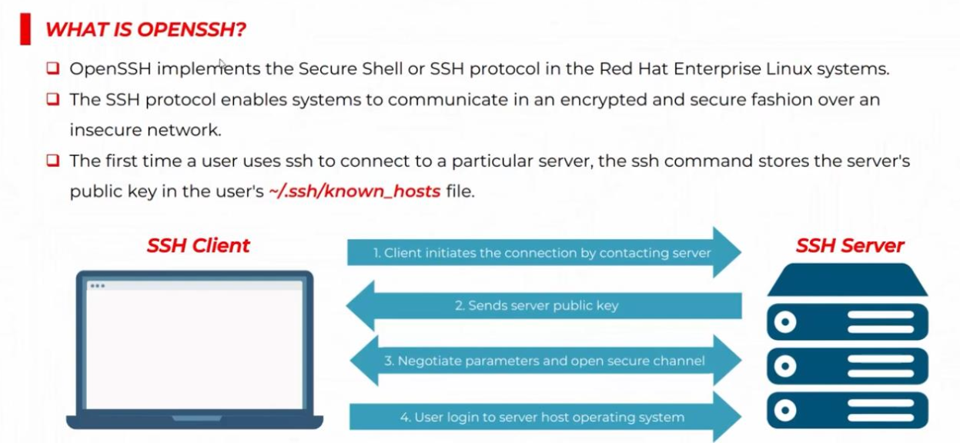
0

Slide 62
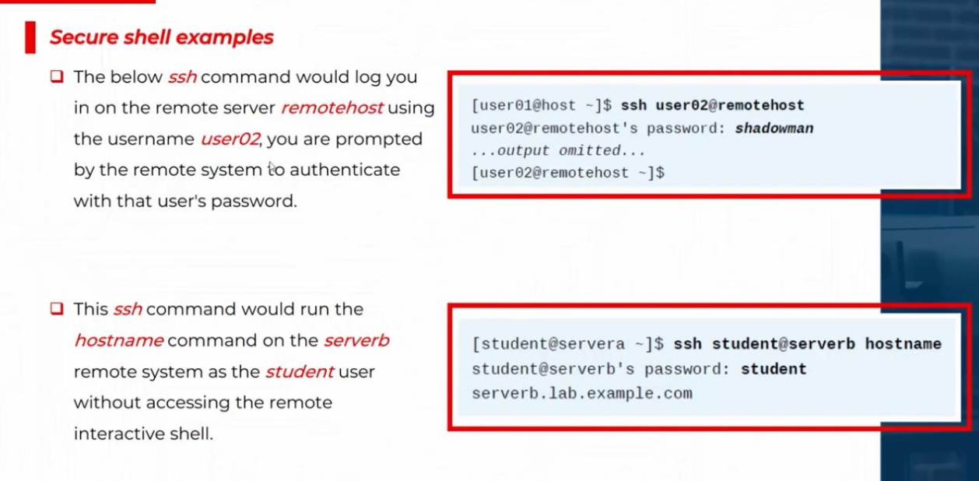

Slide 63


Slide 64


Slide 65


Slide 66

System Logging

Slide 67

System log files

Slide 68

Syslog priorities

Slide 69

Reviewing syslog file

Slide 70

Logs in real time
Monitoring one or more log files for events is helpful to reproduce problems and issues.
The tail -f/path/to/file command outputs the last 10 lines of the file specified and continues to output new lines in the file as they get written.

Slide 71

journalctl

Slide 72



Time configuration

Slide 73


Slide 74


Slide 75


Slide 76


Slide 77


Slide 78


Slide 79
Installing SW packages
Goal
Download, install, update, and manage software packages from Red Hat and Yum package repositories.
Install, update, or remove software packages using Yum and RPM tools.
Objectives

Slide 80


Slide 81


Slide 82


Slide 83


Slide 84


Slide 85


Slide 86


Slide 87


Slide 88


Slide 89


Slide 90


Slide 91


Slide 92


Slide 93


Slide 94


Slide 95


Slide 96


Slide 97


Slide 98


Slide 99


Slide 100
Thank you

